Slide 1
AFib Toolkit Social Media Content: COVID-19 and Beyond
This document provides proposed social copy and creative assets for Facebook and Twitter to help you boost your social media presence online and bring awareness to the importance of managing AFib and connecting with your EP during COVID-19. Feel free to use this copy and/or customize it for your hospital/practice.
THERMOCOOL® Navigation Catheters are indicated for the treatment of drug refractory recurrent symptomatic paroxysmal atrial fibrillation, when used with CARTO® 3 Systems (excluding NAVISTAR® RMT THERMOCOOL® Catheter).
As with any medical treatment, individual results may vary. Only a cardiologist or electrophysiologist can determine whether ablation is an appropriate course of treatment. There are potential risks including bleeding, swelling or bruising at the catheter insertion site, and infection. More serious complications are rare, which can include damage to the heart or blood vessels; blood clots (which may lead to stroke); heart attack, or death. These risks need to be discussed with your doctor and recovery takes time. The success of this procedure depends on many factors, including your physical condition and your body’s ability to tolerate the procedure. Use care in the selection of your doctors and hospital, based on their skill and experience.
Important information: Prior to use, refer to the instructions for use supplied with this device for indications, contraindications, side effects, warnings and precautions.
Caution: US law restricts this device to sale by or on the order of a physician
©Biosense Webster, Inc. 2020 120732-200415

Slide 2
IMAGE (Right click, choose “Save as Picture” to save locally)
COPY:
Don’t ignore your AFib symptoms or delay treatment, even during COVID-19. Studies have shown that AFib treatment is more effective when treated earlier. Talk to your electrophysiologist today to learn more about your risk for other complications, such as stroke and heart failure.
[LINK: https://www.getsmartaboutafib.com/]
142363-200604

Slide 3
IMAGE (Right click, choose “Save as Picture” to save locally)
COPY:
If left untreated, #AFib can be detrimental to your quality of life. Even during COVID-19, it’s important to get in touch with an electrophysiologist who can help you explore catheter ablation for treating your AFib.
[LINK: https://www.getsmartaboutafib.com/]
142363-200604

Slide 4
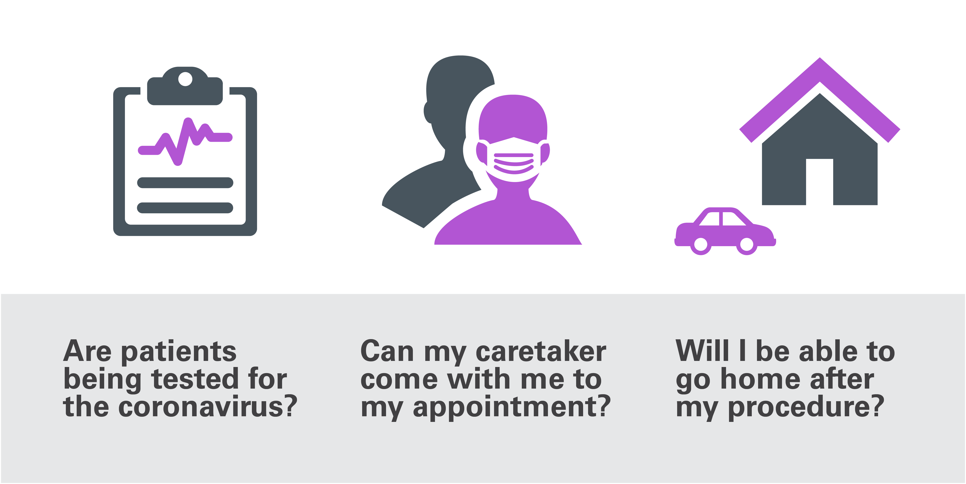
IMAGE (Right click, choose “Save as Picture” to save locally)
COPY:
Considering a catheter ablation to treat your #AFib? Talk to your doctor about the measures their hospital is taking to keep patients safe, including screening for COVID-19.
[LINK: https://www.getsmartaboutafib.com/]
142363-200604

Slide 5
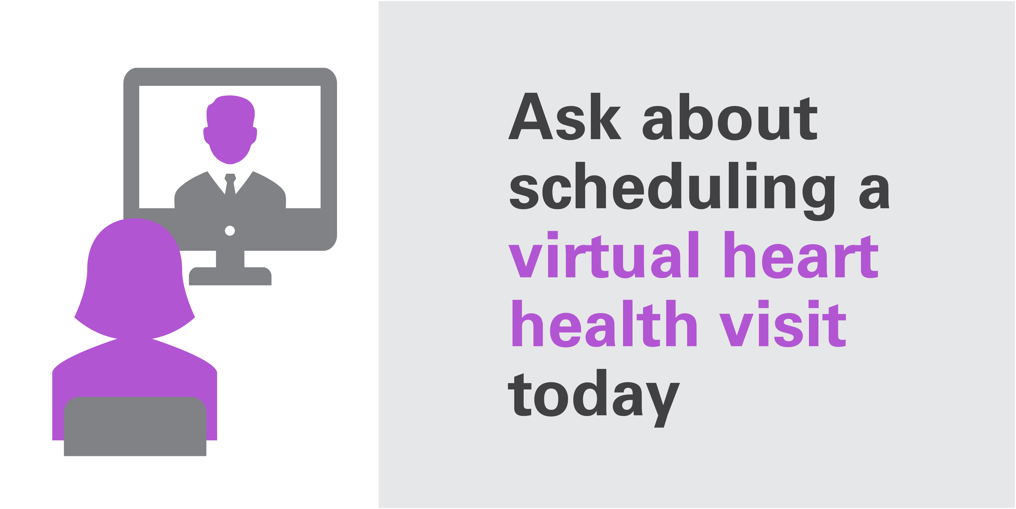
IMAGE (Right click, choose “Save as Picture” to save locally)
Don’t delay! Take charge of your heart health today! If COVID-19 is keeping you at home, ask your electrophysiologist about scheduling a virtual heart health visit.
Don’t delay! Take charge of your heart health today! If COVID-19 is keeping you at home, ask your electrophysiologist about scheduling a virtual heart health visit.
COPY:
Don’t delay! Take charge of your heart health today! If COVID-19 is keeping you at home, ask your electrophysiologist about scheduling a virtual heart health visit.
[LINK: https://www.getsmartaboutafib.com/]
142363-200604

