Slide 1
AFib Toolkit Social Media Content: Patient-Facing
This document provides proposed social copy and creative assets for Facebook and Twitter to help you boost your social media presence online and bring awareness to AFib and catheter ablation as a treatment option. Feel free to use this copy and/or customize it for your hospital/practice.
THERMOCOOL® Navigation Catheters are indicated for the treatment of drug refractory recurrent symptomatic paroxysmal atrial fibrillation, when used with CARTO® 3 Systems (excluding NAVISTAR® RMT THERMOCOOL® Catheter).
As with any medical treatment, individual results may vary. Only a cardiologist or electrophysiologist can determine whether ablation is an appropriate course of treatment. There are potential risks including bleeding, swelling or bruising at the catheter insertion site, and infection. More serious complications are rare, which can include damage to the heart or blood vessels; blood clots (which may lead to stroke); heart attack, or death. These risks need to be discussed with your doctor and recovery takes time. The success of this procedure depends on many factors, including your physical condition and your body’s ability to tolerate the procedure. Use care in the selection of your doctors and hospital, based on their skill and experience.
Important information: Prior to use, refer to the instructions for use supplied with this device for indications, contraindications, side effects, warnings and precautions.
Caution: US law restricts this device to sale by or on the order of a physician
©Biosense Webster, Inc. 2020 120732-200415

Slide 2
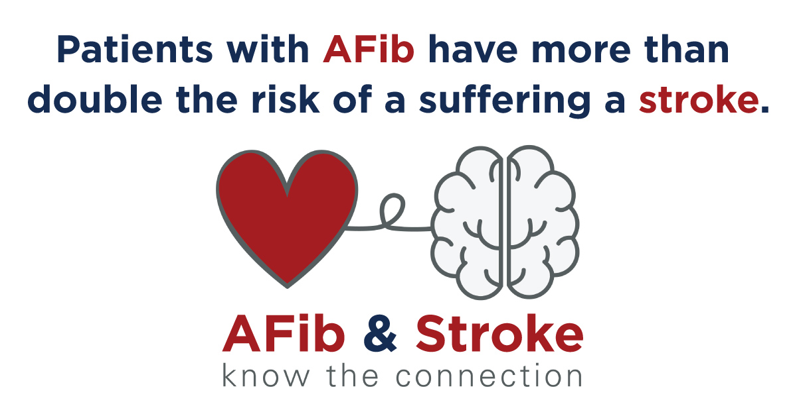
IMAGE (Right click, choose “Save as Picture” to save locally)
COPY:
AFib patients have a high risk of stroke and other cardiac events. Talk to your electrophysiologist today about your risk for Afib and stroke.
[LINK: https://www.getsmartaboutafib.com/]
REF: Odutayo A, Wong CX, Hsiao AJ, Hopewell S, Altman DG et al. (2016) Atrial fibrillation and risks of cardiovascular disease, renal disease, and death: systematic review and meta‐ analysis. Bmj 354 i4482

Slide 3
IMAGE (Right click, choose “Save as Picture” to save locally)
COPY:
Many patients are unaware of their AFib until they suffer a stroke. Talk to a skilled electrophysiologist today about your risks form AFib.
[LINK: https://www.getsmartaboutafib.com/]
REF: Boriani G, Laroche C, Diemberger I, Fantecchi E, Popescu MI et al. (2015) Asymptomatic atrial fibrillation: clinical correlates, management, and outcomes in the EORP‐ AF Pilot General Registry. Am J Med 128 (5): 509‐518 e502.

Slide 4
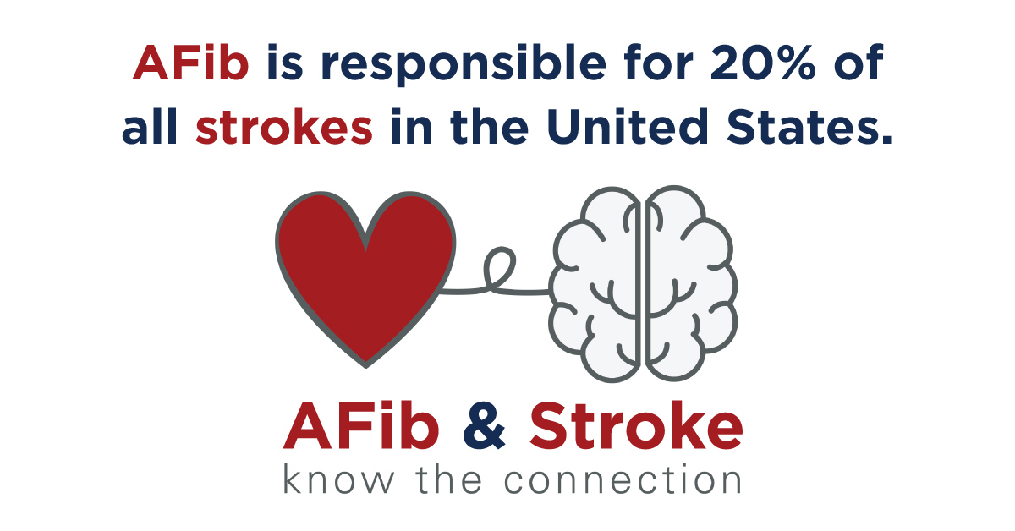
IMAGE (Right click, choose “Save as Picture” to save locally)
COPY:
AFib is responsible for up to a fifth of all strokes in the US, don’t you think it’s time to talk to your electrophysiologist about Afib and Stroke risk?
[LINK: https://www.getsmartaboutafib.com/]
REF: Zoni‐Berisso M, Lercari F, Carazza T, Domenicucci S (2014) Epidemiology of atrial fibrillation: European perspective. Clin Epidemiol 6 213‐220.

Slide 5
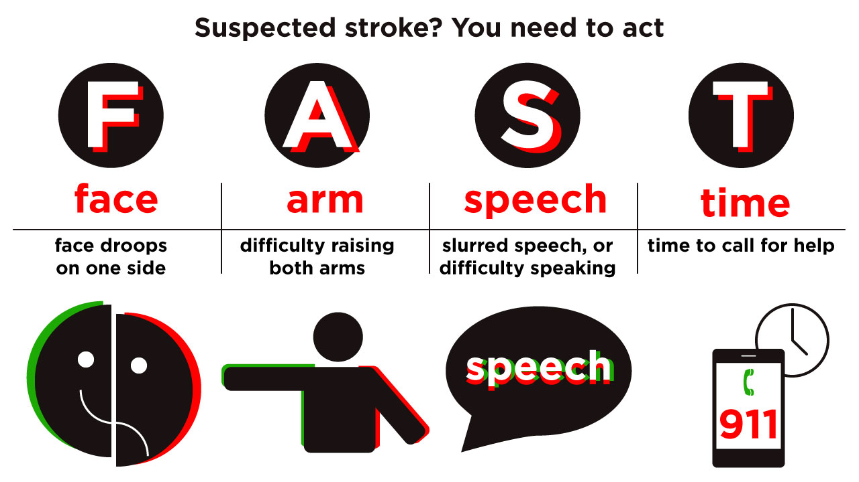
IMAGE (Right click, choose “Save as Picture” to save locally)
COPY:
Time is of the essence! In cases of suspected stroke think FAST and if you recognize these symptoms, call for help immediately. #strokeawarenessmonth
[LINK: NONE]
REF: https://www.cdc.gov/stroke/signs_symptoms.htm

Slide 6
IMAGE (Right click, choose “Save as Picture” to save locally)
COPY:
Stroke awareness means recognizing the symptoms of stoke to empower you to act FAST and get help for the victim quickly. #strokeawarenessmonth
[LINK: NONE]
REF: https://www.cdc.gov/stroke/signs_symptoms.htm

Slide 7
IMAGE (Right click, choose “Save as Picture” to save locally)
COPY:
Stroke awareness means recognizing the symptoms of stoke to empower you to act FAST and get help for the victim quickly. #strokeawarenessmonth
[LINK: NONE]
REF: https://www.cdc.gov/stroke/signs_symptoms.htm

Slide 8
IMAGE (Right click, choose “Save as Picture” to save locally)
COPY:
Follow these simple steps to a healthier heart. Get started in #HeartHealthMonth to lower your risk for heart disease.
[LINK: https://www.cdc.gov/features/heartmonth/index.html]

Slide 9
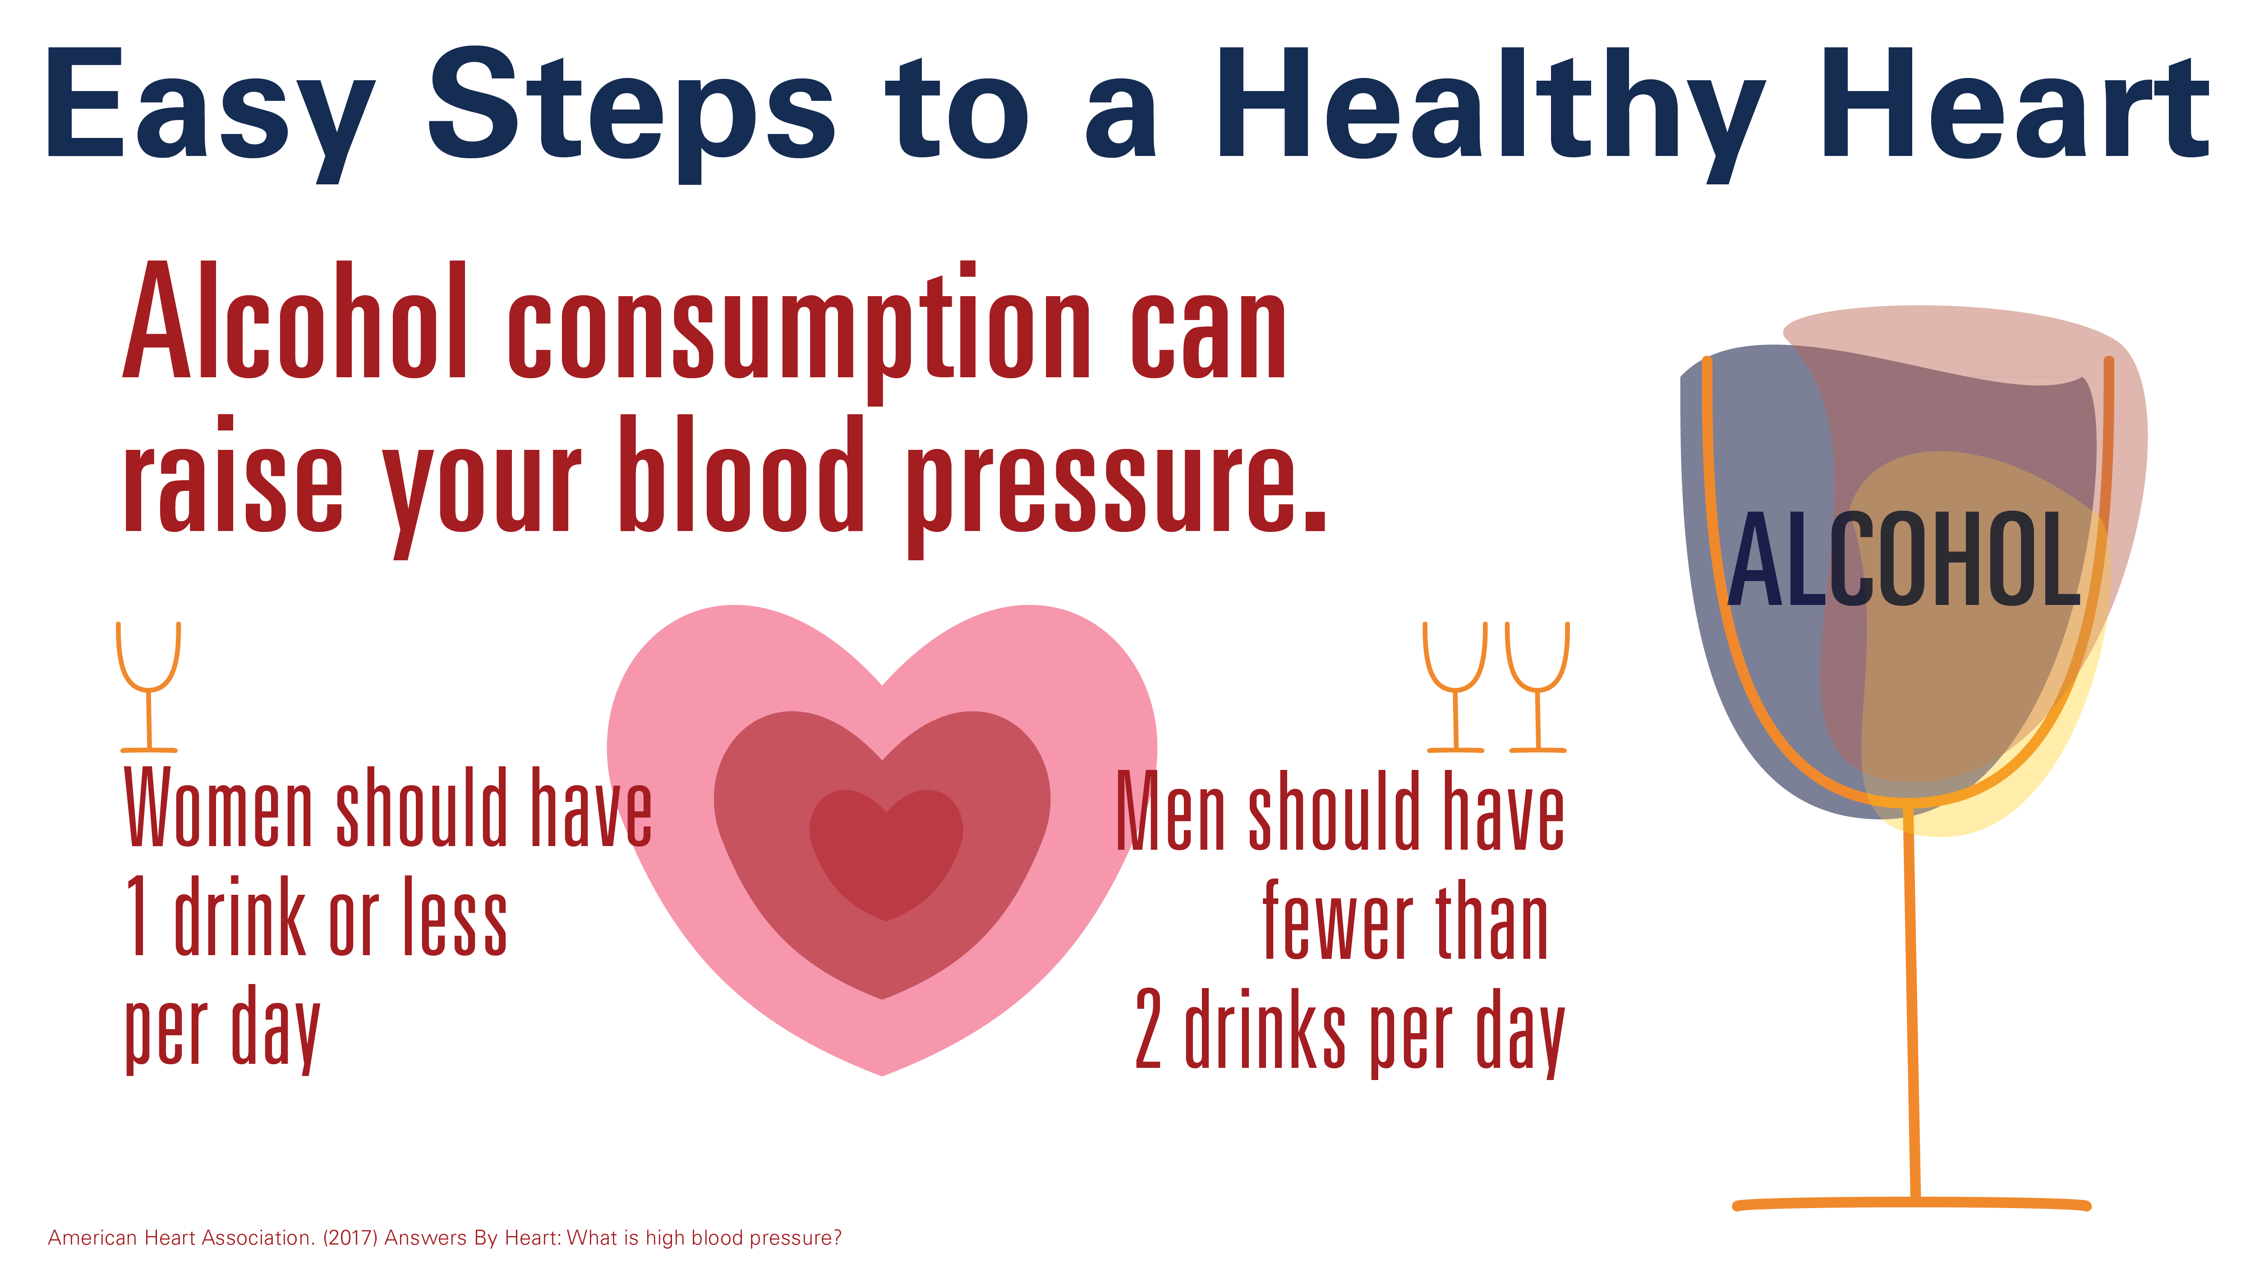
IMAGE (Right click, choose “Save as Picture” to save locally)
COPY:
Follow these simple steps to a healthier heart. Get started in #HeartHealthMonth to lower your alcohol intake and your blood pressure.
[LINK: https://www.cdc.gov/bloodpressure/healthy_living.htm]

Slide 10
IMAGE (Right click, choose “Save as Picture” to save locally)
COPY:
Follow these simple steps to a healthier heart. Get active for #HeartHealthMonth and lower your risk for heart disease.
[LINK: https://www.cdc.gov/features/heartmonth/index.html]

Slide 11
IMAGE (Right click, choose “Save as Picture” to save locally)
COPY:
Follow these simple steps to a healthier heart. Get active for #HeartHealthMonth and lower your risk for heart disease.
[LINK: https://www.cdc.gov/features/heartmonth/index.html]

Slide 12
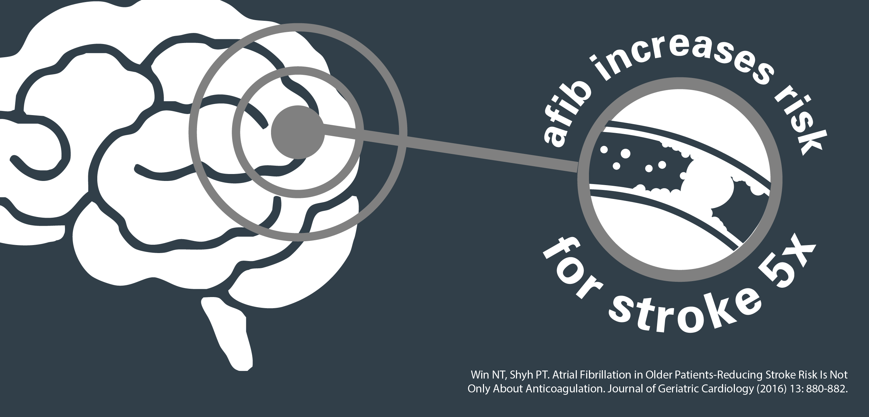
IMAGE (Right click, choose “Save as Picture” to save locally)
COPY:
If untreated, #AFib can increase your risk of having a stroke five-fold. Learn more about AFib symptoms so you can get the help you need.
[LINK: https://www.getsmartaboutafib.com/what-is-afib]

Slide 13
IMAGE (Right click, choose “Save as Picture” to save locally)
COPY:
Each year, more than 130,000 deaths are caused from #AFib. This number is way too high when there are treatments to help.
[LINK: https://www.getsmartaboutafib.com/what-is-afib]

Slide 14
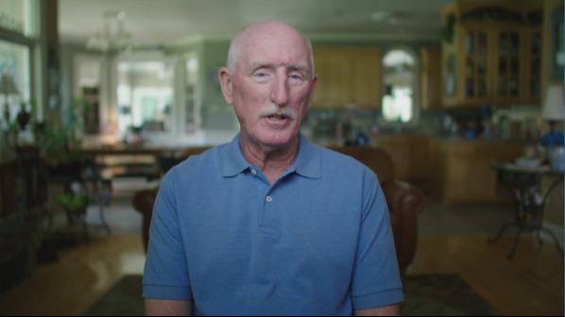
VIDEO (Click link to download video)
COPY:
#AFib can be detrimental to an individual’s quality of life. Hear from real patients how catheter ablation helped change this.
[LINK: https://www.getsmartaboutafib.com/patient-stories]

Slide 15
VIDEO (Click link to download video)
COPY:
While the most common symptom of #AFib is a quivering heartbeat, others are more subtle. Watch to hear patients share their diagnosis story.
[LINK: https://www.getsmartaboutafib.com/patient-stories]

Slide 16
IMAGE (Right click, choose “Save as Picture” to save locally)
COPY:
Do you know what #AFib is and why detection is important? Get educated this #AFibAwarenesMonth!
[LINK: https://www.getsmartaboutafib.com/what-is-afib]

Slide 17
IMAGE (Right click, choose “Save as Picture” to save locally)
COPY:
#DYK #AFib effects more than 33 M people worldwide? Get smart this #AFibAwareness Month!
[LINK: https://www.getsmartaboutafib.com/what-is-afib]

Slide 18
IMAGE (Right click, choose “Save as Picture” to save locally)
COPY:
A common symptom of #AFib is a quivering heartbeat but others include fatigue, dizziness, and shortness of breath. Learn more about treatment options like catheter ablation.
[LINK: https://www.getsmartaboutafib.com/symptoms]

Slide 19
IMAGE (Right click, choose “Save as Picture” to save locally)
COPY:
Catheter ablation has been proven to effectively help many people living with #AFib. Talk to your cardiologist to learn more or find an electrophysiologist in your area:
[LINK: https://www.getsmartaboutafib.com/catheter-ablation]

Slide 20
IMAGE (Right click, choose “Save as Picture” to save locally)
COPY:
#DYK nearly half of #AFib patients still experience symptoms when using drug therapy. Often, catheter ablation, a procedure we do at [INSERT CLINIC], can be more effective in treating #AFib. Learn more:
[LINK: https://www.getsmartaboutafib.com/what-is-afib]

Slide 21
COPY:
Catheter ablation is a procedure targeting areas of the heart that generate faulty electrical pulses that cause #AFib. Interested in this procedure? Learn more:
[LINK: https://www.getsmartaboutafib.com/what-is-afib]
TWITTER IMAGE - NONE

Slide 22
IMAGE (Right click, choose “Save as Picture” to save locally)
COPY:
Catheter ablation procedures to treat #AFib are on the rise. [INSERT CLINIC] has been doing this procedure for X years. Learn more:
[LINK: https://www.getsmartaboutafib.com/what-is-afib]

