Slide 1
AFib Toolkit Social Media Content: EP-Facing
This document provides proposed social copy and creative assets for Facebook, Twitter and LinkedIn to help you boost your social media presence online and bring awareness to AFib and catheter ablation as a treatment option. Feel free to use this copy and/or customize it for your hospital/practice.
THERMOCOOL® Navigation Catheters are indicated for the treatment of drug refractory recurrent symptomatic paroxysmal atrial fibrillation, when used with CARTO®3 Systems (excluding NAVISTAR® RMT THERMOCOOL® Catheter).
As with any medical treatment, individual results may vary. Only a cardiologist or electrophysiologist can determine whether ablation is an appropriate course of treatment. There are potential risks including bleeding, swelling or bruising at the catheter insertion site, and infection. More serious complications are rare, which can include damage to the heart or blood vessels; blood clots (which may lead to stroke); heart attack, or death. These risks need to be discussed with your doctor and recovery takes time. The success of this procedure depends on many factors, including your physical condition and your body’s ability to tolerate the procedure. Use care in the selection of your doctors and hospital, based on their skill and experience.
Important information: Prior to use, refer to the instructions for use supplied with this device for indications, contraindications, side effects, warnings and precautions.
Caution: US law restricts this device to sale by or on the order of a physician
©Biosense Webster, Inc. 2021 120953-210202

Slide 2
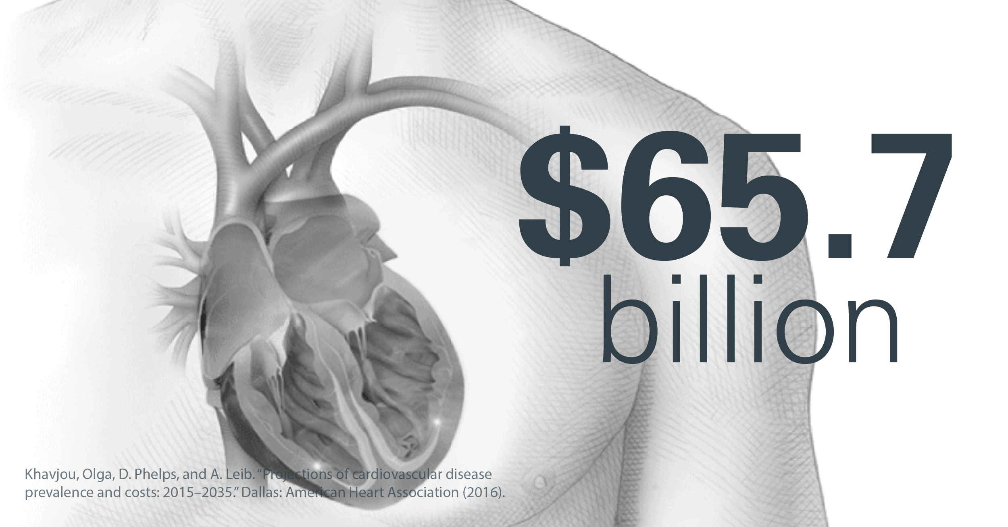
FACEBOOK IMAGE (Right click, choose “Save as Picture” to save locally)
Note: Facebook and Twitter cards are different dimensions.
FACEBOOK COPY:
Did you know costs for treating AFib are expected to grow to $65.7 billion by 2035? My fellow #Epeeps and I are dedicated to changing this.
[LINK: NONE]

Slide 3
TWITTER IMAGE (Right click, choose “Save as Picture” to save locally)
Note: Facebook and Twitter cards are different dimensions.
TWITTER COPY:
#Epeeps: Incremental costs for treating #AFib are expected to grow to $65.7 billion by 2035. We can change this!
[LINK: NONE]

Slide 4
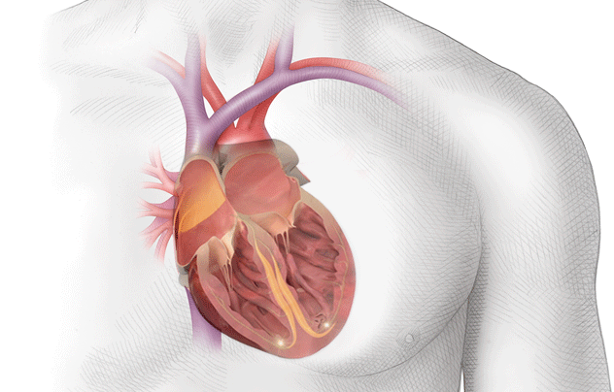
FACEBOOK IMAGE (Right click, choose “Save as Picture” to save locally)
Note: Facebook and Twitter cards are different dimensions.
**This image is an animated GIF of a heart in Afib; it animates on Facebook and Twitter
FACEBOOK COPY:
Need help explaining catheter ablation to your patients? Check out the Get Smart About AFib website:
[LINK: https://www.getsmartaboutafib.com/what-is-afib]

Slide 5
TWITTER IMAGE (Right click, choose “Save as Picture” to save locally)
Note: Facebook and Twitter cards are different dimensions.
**This image is an animated GIF of a heart in Afib; it animates on Facebook and Twitter
TWITTER COPY:
#Epeeps: Need help explaining catheter ablation to your patients? Check out @BiosenseWebster’s Get Smart About AFib website:
[LINK: https://www.getsmartaboutafib.com/what-is-afib]

Slide 6
TWITTER IMAGE (Right click, choose “Save as Picture” to save locally)
Note: Facebook and Twitter cards are different dimensions.
TWITTER COPY:
Did you know that #AFib disproportionately affects Black Americans? My fellow #EPeeps and I are dedicated to raising awareness and finding the right treatment for all patients: https://www.getsmartaboutafib.com/ #HeartMonth

Slide 7
LINKEDIN IMAGE (Right click, choose “Save as Picture” to save locally)
Note: Facebook and Twitter cards are different dimensions.
LINKEDIN COPY:
Did you know there are major racial disparities when it comes to heart health and #AFib? Join me this #HeartMonth to educate yourself and your patients: https://www.getsmartaboutafib.com/ #EPeeps

Slide 8
TWITTER IMAGE (Right click, choose “Save as Picture” to save locally)
Note: Facebook and Twitter cards are different dimensions.
TWITTER COPY:
This #HeartMonth, let’s focus on recognizing the higher prevalence of #AFib risk factors in Black patients and the importance of early diagnosis & treatment: https://www.getsmartaboutafib.com/

Slide 9
LINKEDIN IMAGE (Right click, choose “Save as Picture” to save locally)
Note: Facebook and Twitter cards are different dimensions.
LINKEDIN COPY:
February is #HeartMonth and there’s no better time to recognize the #AFib disparities that exist among Black patients. Learn about the higher prevalence of #AFib risk factors in Black patients and the importance of early diagnosis & treatment: https://www.getsmartaboutafib.com/ #EPeeps

